Slide 1
Polysaccharides
Polysaccharides, or glycans, are high-molecular carbohydrates containing more than ten monosaccharide units linked by glycoside bonds.
Polysaccharides differ from one another in the: 1- nature of monosaccharides involved
molecular mass or length of their chains
type of chain-linking glycoside bonds. 4- Degree of branching.
The most common monomeric unit in monosaccharides that occur are galactose, derivatives.
polysaccharides is mannose, fructose,
D-glucose. Other and monosaccharide

Slide 2
Distinguished are homopolysaccharides (homoglycans) built of only one type of monosaccharides and heteropolysaccharides (heteroglycans) composed of different types of monosaccharides.
For example, starch is a homopolysaccharide, since it contains D-glucose only, while hyaluronic acid is a heteropolysaccharide, since it is made up of alternating units of D- glucuronic acid and N-acetyl-D-glucosamine.
Polysaccharides are also subdivided into linear and branched species, according to the structural type of their polymeric chains.
General properties of polysaccharides:
Polysaccharides exhibit typical properties common to high-molecular compounds bearing
polar groups. Thence, polysaccharides are hydrophilic; when placed in water, they swell (similar to fibrous proteins) and then dissolve partially to form colloidal solutions.

Slide 3
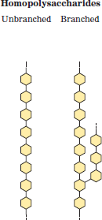
Polysaccharides are contained both inside the cells and in the extracellular matter. This signifies that the characteristic properties of polysaccharides show up under a variety of conditions. As a rule, neutral polysaccharides inside the cells are intended as reserve material (starch or glycogen). Acidic polysaccharides (hyaluronic acid and chondroitin sulphate) are commonly found in the extracellular space.
Individual polysaccharides: Homopolysaccharides:
The structures for the most widespread homopolysaccharides
are presented below and these homopolysaccharides contain only a single type of monomers:

Slide 4
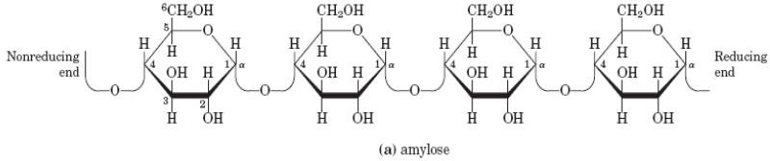
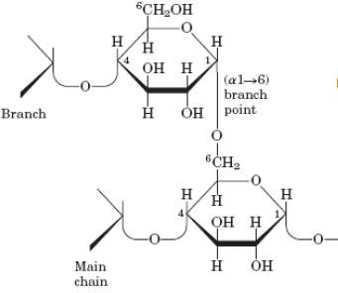
Some examples:
Starch is a homopolysaccharide found in plants; it consists of α-amylose and amylopectin.

Slide 5
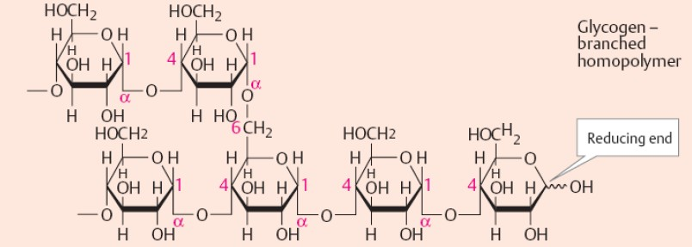
Glycogen is the major short-term storage polysaccharide found in all human and animal tissues. In small amounts, glycogen is also present in bacteria and plants.
Glycogen structure

Slide 6
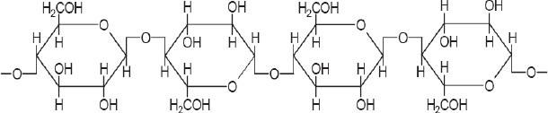
Cellulose is a structural homopolysaccharide of plants.
cellulose structure
Heteropolysaccharides:
These polysaccharides are contain two or more different kinds of monomer units and the structures are presented below:

Slide 7
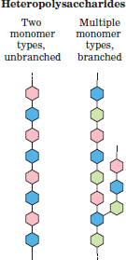
They all are found in the extracellular space in the tissues of multicellular animals, the extracellular matrix, also called ground substance, which holds the cells together and provides a porous pathway for the diffusion of nutrients and oxygen to individual cells.
Heteromacromolecules are referred to as proteoglycans or glucosamine proteoglycans.

Slide 8
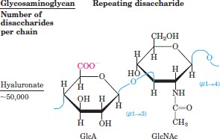
Some examples:
Hyaluronic acid is linear heteropolysaccharide. It has the greatest molecular mass among the heteropolysaccharides. It serves as the biological cement filling the intercellular space.
Hyaluronic acid

Slide 9
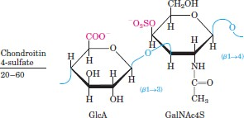
Chondroitin sulphates are the most abundant acidic heteropolysaccharides in human and animal tissues. They occur in skin, bone tissue, cartilage, etc.
Chondroitin sulphates

Slide 10
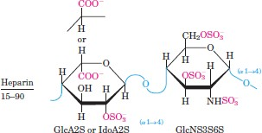
Heparin is distinct from other acidic heteropolysaccharides, they are not structural components for the extracellular material. In blood heparin is noncovalently bound to specific proteins. The complex of heparin with glycoprotein of plasma exhibits an anticoagulatory activity, while the complex of heparin with the enzyme lipoprotein lipase is capable of cleaving lipids found in the blood as chylomicrons.
Heparin

Slide 11
Biological functions of polysaccharides:
The essential functions of polysaccharides are:
energetic
supportive
protective
colligative (structural)
hydroosmotic and ion-regulating
cofactor.
Digestive mechanism for carbohydrates:
The digestion of carbohydrates starts in the oral cavity, mainly through the agency of
salivary α- amylase. Certain scientists believe that another enzyme, maltase, is also present in the saliva.

Slide 12
α-Amylase is composed of a single polypeptide chain; it is acts on the glycoside bonds and hydrolyzing the glycoside bonds of these polysaccharides. By the action of α-amylase, the polysaccharides are split into a limit- dextrin, maltose, and a small amount of glucose. Maltose is formed as the end product. Disaccharides undergo hydrolysis and the monosaccharides formed are immediatelly absorbed. α-Oligosaccharidases include maltase,
sucrase, lactase:
Maltase
Maltose + H2O
Sucrase
2 glucose
Sucrose + H2O
glucose + fructose
Lactase
Lactose + H2O glucose + galactose
The end products of carbohydrate digestion are monosaccharides, mostly glucose, fructose, and galactose.

